Slide 1



StayEase: Revolutionizing Hotel Booking
Unlock your perfect stay with our seamless hotel booking app – Where comfort meets convenience, and every journey finds its ideal home.

Slide 2

Team Members
C.Chinmayee N.Tulasi
Lalitha P.Trisha
2210030380 2210030388
2210030372 2210030338

Slide 3

Introduction to Hotel Booking App
1
User-Centric Design
2
Seamless Experience
The app interface is intuitively designed, allowing users to navigate effortlessly through the booking process.
Integration of advanced technologies ensures a smooth and hassle-free booking experience for customers.
3
Customizable Options
StayEase provides a range of customizable choices, allowing users to tailor their stay according to their preferences.

Slide 4

Integration of MERN Stack
Powerful Technology Fusion
Scalable and Efficient
The integration of MERN stack provides a robust foundation, combining MongoDB, Express.js, React, and Node.js for dynamic functionality.
MERN stack architecture empowers the app to handle large volumes of data while maintaining high performance.

Slide 5





Key Features of StayEase Booking App
Advanced Search Filters
Users can easily filter through extensive options, ensuring they find the perfect accommodation.
Real-time Availability
StayEase provides live availability updates, enabling users to make informed booking decisions.
Effortless Reservation Management
StayEase offers a user-friendly reservation management system, allowing guests to easily modify or cancel bookings with convenience and confidence.

Slide 6
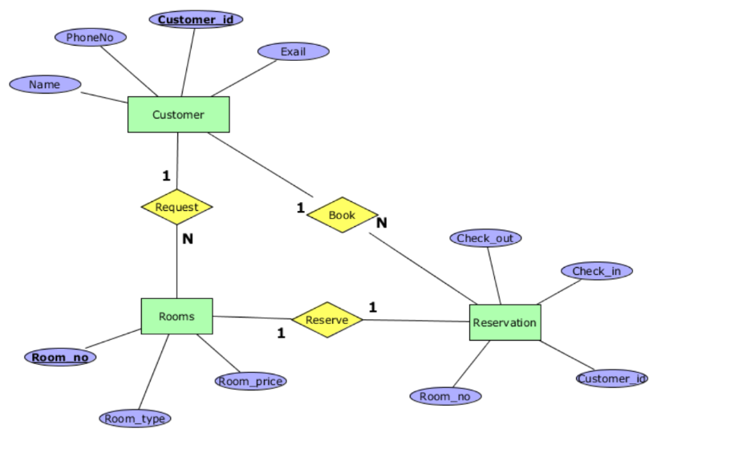
E R Diagram

Slide 7
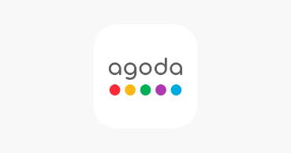

Existing Hotel Booking Apps
Some users feel that recommendations on Trivago and Agoda lack personalization.
Provide real-time updates on room availability, prices, and booking confirmations. This ensures users receive accurate and timely information.
Users may feel overwhelmed with the extensive list of search results, leading to decision fatigue.

Slide 8

Conclusion and Future Enhancements
Our MERN hotel booking project is not just a platform for reservations but a comprehensive solution that combines technological innovation, user-centric design, and a commitment to excellence in the hospitality sector. We look forward to reshaping the way users experience and engage with hotel bookings, creating a lasting impact in the world of travel and accommodation.

Slide 9


Thank You

